Slide 1
Precision Care Challenge 2025
Phase 1 – Idea Submission

Slide 2


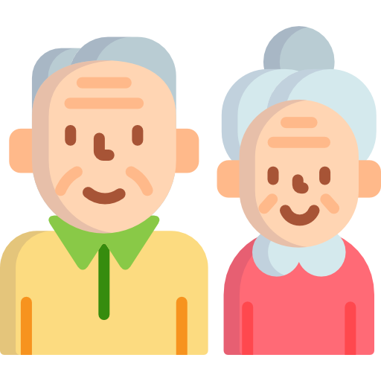


Problem We Are Solving
The Challenge
Primary Problems
Limited Personalization: Google searches are so common that rather than help, they confuse parents more. Eg: A mother googles “vomiting in baby” and everything she finds pertains to adult illnesses.
Information Not Localized: Parents know a vaccine is needed, but not where to get it, how much it costs, or if it is urgent.
Loss of Traditional Knowledge: In the past, new parents learned from grandparents. Now, in urban areas, grandparents aren't around due to urban migration, and parents are more likely to have nuclear family units.
Overwhelmed Healthcare System: India's doctor to patient ratio is 1 : 1,511 (1:1,000 vs WHO ideal), therefore, parents often can't get timely guidance when things happen with babies.
The first 1000 days of life are vital to a child's brain and physical development. Yet, Indian parents, especially in low-income or nuclear family settings, face critical challenges
The Impact
Rising anxiety, over-dependence on misinformation.
Missed or late vaccines.
Preventable complications in nutrition, hygiene, or illnesses.
2

Slide 3


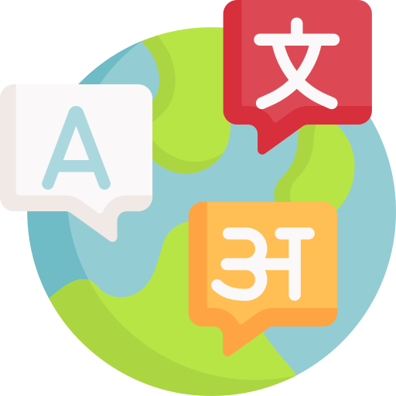


Briefly Explain Your Idea/Solution
Uniqueness of the Solution
Conversational AI (LLM) + Vision AI (VLM)
Indian regional languages, Hinglish input, and voice support
Actionable location-based insights (hospital, vaccines)
Offline-ready fallback and low-literate user design
3

Slide 4

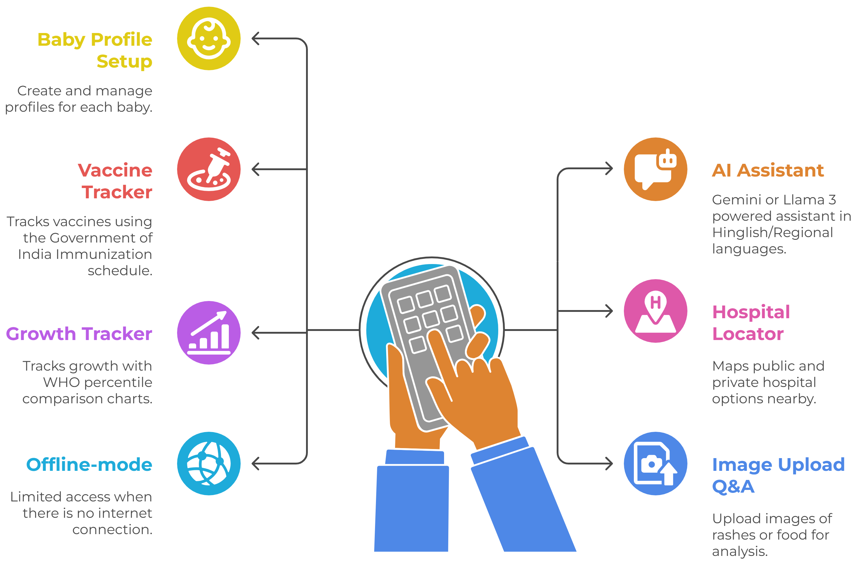


Medical validation still required for edge cases
Explanation of the Solution
How BacchaSaathi Works
Key Features
Parents input a question or upload a baby-related photo.
The LLM/VLM processes and gives personalized, human-like responses. Data saved locally for offline re-check.
Vaccine reminders auto-triggered based on date of birth.
Advantages & Limitations
Advantages
Limitations
Personalized, safe advice rooted in Indian context
Scalable to integrate with Govt. ASHA networks
Can add multilingual voice and text interaction
HIPAA & GDPR compliant for secure data use
Medical validation still required for edge cases
Image-based AI may need clinical tuning
4

Slide 5
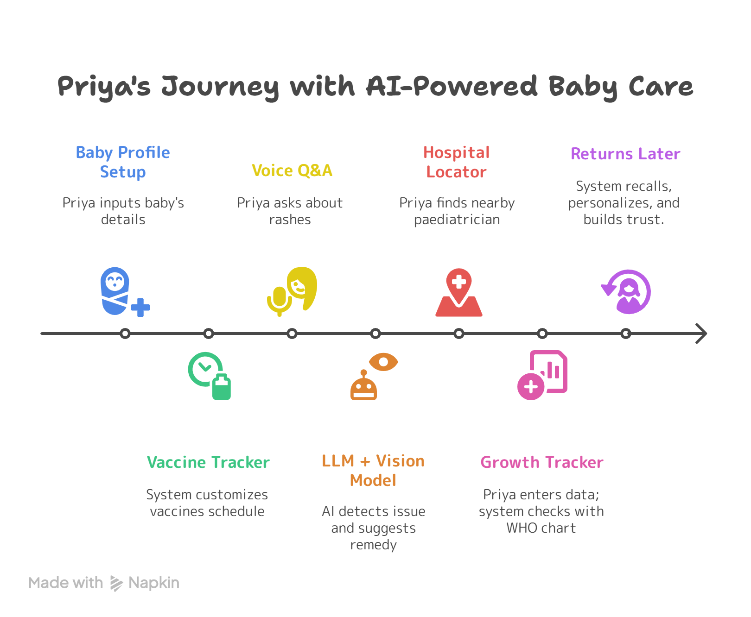
Example User Journey: Priya, a First-Time Mother from Bhopal
Background
Priya, a 27-year-old first-time mother from a semi-urban area in Bhopal, has basic smartphone access. She speaks Hindi and prefers audio over text. Her baby is 6 months old.
How Priya Uses BacchaSaathi Step-by-Step
5

